Slide 1
Effect of Accelerating Voltage on SEM Resolution
Hong Koh Yiin
-CAMTEC 2011-
Image from: http://www.sciencephoto.com/media/99504/enlarge

Slide 2
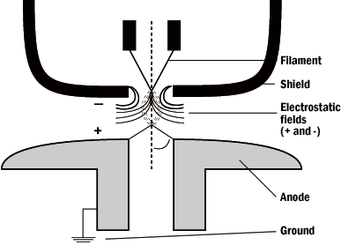
Accelerating Voltage
Voltage difference between the filament (cathode) and the anode
Accelerates the electron beam towards the anode.
Notes:
Cold cathode field emission sources do not heat the filament material. The electrons are drawn from field emission gun by placing the filament at a huge electrical potential gradient, so large that the work function of the material is overcome, and electrons are drawn off of the filament. Field emission systems require extremely high, clean vacuums in which to operate
Field emission sources utilize two anode plates placed below the gun assembly. Associated with the first anode is the extraction voltage. The extraction voltage is usually in the range of 3-5 kilovolts, and is the amount of voltage necessary to draw electrons from the source. The second anode has the accelerating voltage associated with it. The accelerating voltage determines the velocity at which the electrons travel down the column. Both of these anodes act as electrostatic lenses, focusing the beam into a small initial crossover.

Slide 3
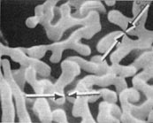
Resolution
The minimum distance that can be separated as two distinguishable points in the SEM image.
SEM Resolution Test Medium
(Al-W Dendrites)
Notes:
In the SEM (which does not operate as a true optical instrument) resolution is dependent upon the size of the area from which signal is emitted from the sample. The size of this area is influenced by many factors including initial size of the primary beam, the composition of the specimen, the energy of the primary beam, and the type of signal that is being imaged. If signal from two separate objects overlap in their region of signal emission, those two objects can not be resolved and the resolution limit of the SEM has been reached. We can always magnify this image further, but resolution will not increase. [Illustration]The SEM cannot match the TEM in terms of resolution. Where the SEM excels is in terms of depth of field. Depth of field is defined as the extent of a zone on the specimen which appears in focus at the same time. This is often confused with depth of focus which is defined as the depth of field in image space, not specimen space. Because of its particular design these terms are fairly interchangeable for the SEM, but for clarity's sake, we will use the term depth of field in referring to the workings of the SEM.The primary factor influencing the depth of field in an SEM is the angle of the beam divergence. The smaller this angle, the greater will be the depth of field. As the beam scans above and below the plane of optimum focus the diameter of the illumination spot is increased. Depending on the distance between raster points and the size of the emission area, this increase in size of the primary beam spot may or may not have an effect on what appears in focus. The greater the distance from the plane of optimal focus that structures on the specimen still appear in focus, the greater the depth of focus.[Fig. 4.9 Gold]Resolution vs. Depth of Field Cont'd:Since depth of field is ultimately dependent of the geometry of the primary beam it can be controlled by altering either working distance or the diameter of the final aperture. The working distance is defined as the distance between the final lens pole piece and the uppermost portion of the specimen. By increasing the working distance the strength of the final lens must be decreased in order to bring the plane of optimal focus in line with the top of the specimen. In doing so the angle of the incident beam is decreased from what is present at a smaller working distance.[Fig. 2-12]The angle of the primary beam can also be reduced by using a smaller final lens aperture. This can be used when the working distance can not be increased further. The major drawback to using ever smaller final lens apertures is that by reducing the amount of illumination one ultimately reduces the amount of signal too.

Slide 4
Relationship between the Accelerating Voltage and the Resolution
Primary electron beam
2
1
Secondary electrons
Resolution (nm)
FE-SEM (S-4800)
Backscattered electrons
X-rays
1 15
Accelerating Voltage (kV)

Slide 5
Secondary electron emission signal – more widely used in SEM
Secondary Electron Detector
Notes:
. A secondary electron is produced when an electron from the primary beam collides with an electron from a specimen atom and loses energy to it. This will serve to ionize the atom and in order to re-establish the proper charge ratio following this ionization event an electron may be emitted. Such electrons are referred to as "secondary" electrons. Secondary electrons are characterized from other electrons by having an energy of less than 50 eV
v

Slide 6
Relationship Between Electrons and Accelerating Voltage
Energy of accelerated electron, E = eV
= ½ mv²
e = charge of electron
V = accelerating voltage
m = rest mass of electron
v = velocity of electron
http://www.microscopy.ethz.ch/properties.htm

Slide 7
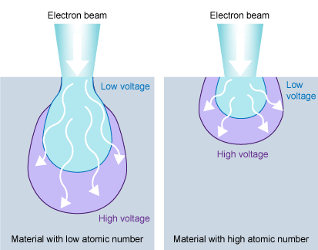
http://www.ammrf.org.au/myscope/sem/practice/principles/voltagevstype.php

Slide 8
Penetration Depth, H = 0.0276 A V ^{1.67} , μm
z^{0.89} ρ
A= atomic weight, g mol⁻¹
V= accelerating voltage, kV
z= atomic number
ρ= density, g cm⁻³
Penetration Depth α Interaction Volume

Slide 9
Penetration Depth in Different Accelerating Voltage
Penetration depth/interaction volume is a direct function of energy.
SrS
5000Å
Si
15 kV 10 kV 5 kV
Notes:
theoretical representation of how deep/how wide the electrons scattering happened on the sample.

Slide 10
High
Unclear surface structures
More edge effect
High Resolution
More charge-up
More beam damage
Accelerating Voltage
Clear surface structures
Less edge effect
Low Resolution
Less charge-up
Less beam damage
Low

Slide 11
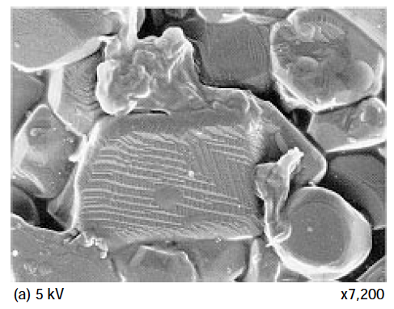
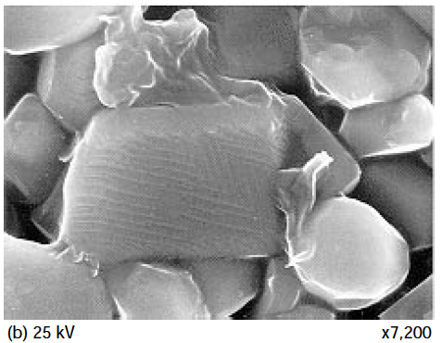
Surface information

Slide 12
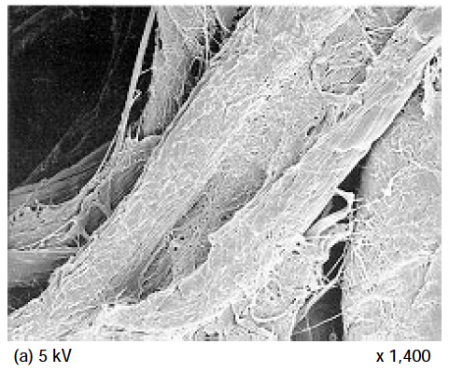
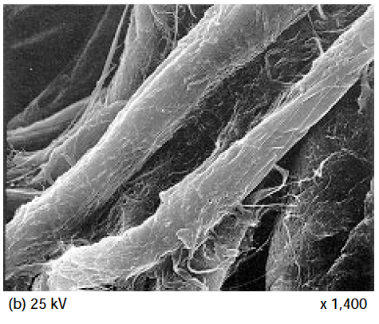

Slide 13
High
Unclear surface structures
More edge effect
High Resolution
More charge-up
More beam damage
Accelerating Voltage
Clear surface structures
Less edge effect
Low Resolution
Less charge-up
Less beam damage
Low

Slide 14
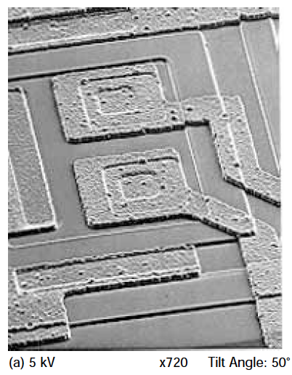
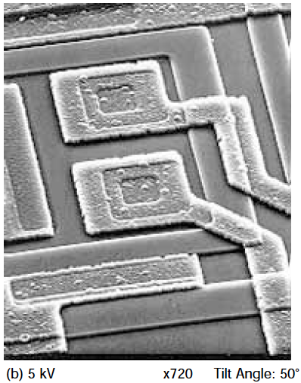
Edge Effect

Slide 15
High
Unclear surface structures
More edge effect
High Resolution
More charge-up
More beam damage
Accelerating Voltage
Clear surface structures
Less edge effect
Low Resolution
Less charge-up
Less beam damage
Low

Slide 16
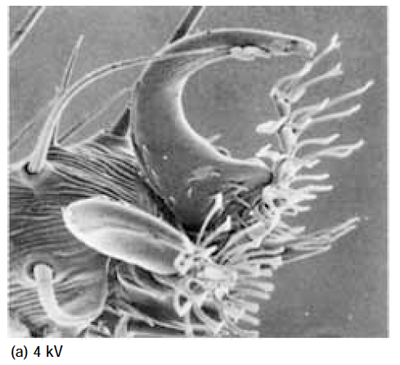
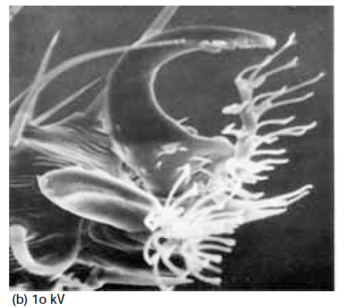
Charge-up
Notes:
Electron build up on less conductive surface

Slide 17
High
Unclear surface structures
More edge effect
High Resolution
More charge-up
More beam damage
Accelerating Voltage
Clear surface structures
Less edge effect
Low Resolution
Less charge-up
Less beam damage
Low

Slide 18
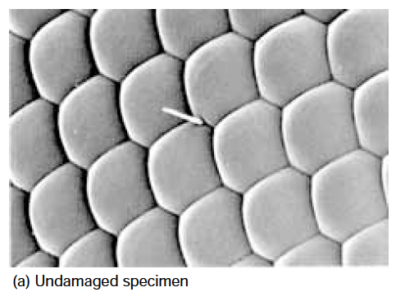
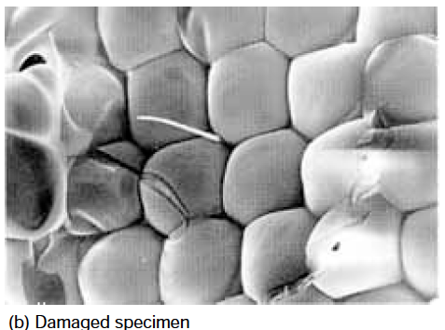
Beam Damage

Slide 19
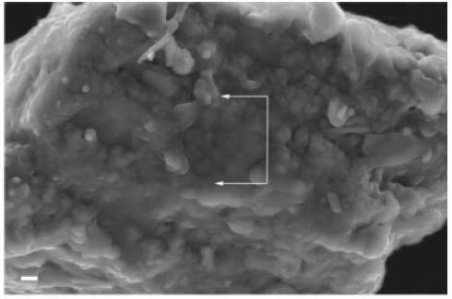
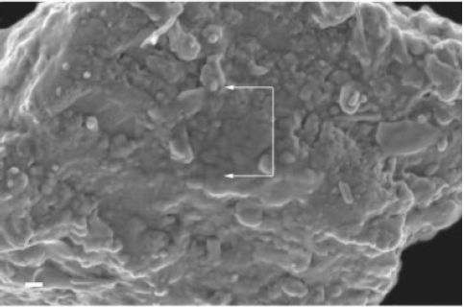
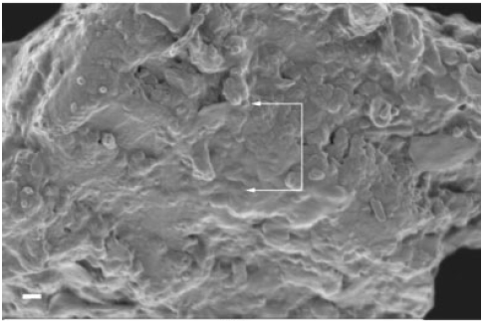
200nm
5 kV, 50000x
2 kV, 50000x
300 V, 50000x
200nm

Slide 20
--The End--

